Slide 1
KJM 3110 Electrochemistry Chapter 14 Other interfaces
Most figures from the textbook we use for the course, via its web resources:

Slide 2
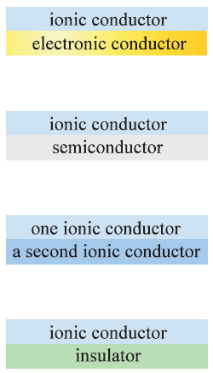
Summary Ch. 13 The electrode interface
Interface
Large capacitance
Nonfaradaic currents
Adsorption
Next chapter: Other interfaces
ionic conductor
metal

Slide 3
Metallic electrodes
So far:
Working electrode is a metal (=is metallic (?))
Always abundance of electrons
Or rather: … of lectrons and states the electrons can be in.
Now, next:
Working electrode is a semiconductor
Not necessarily any longer an abundance of electrons. Or states.

Slide 4
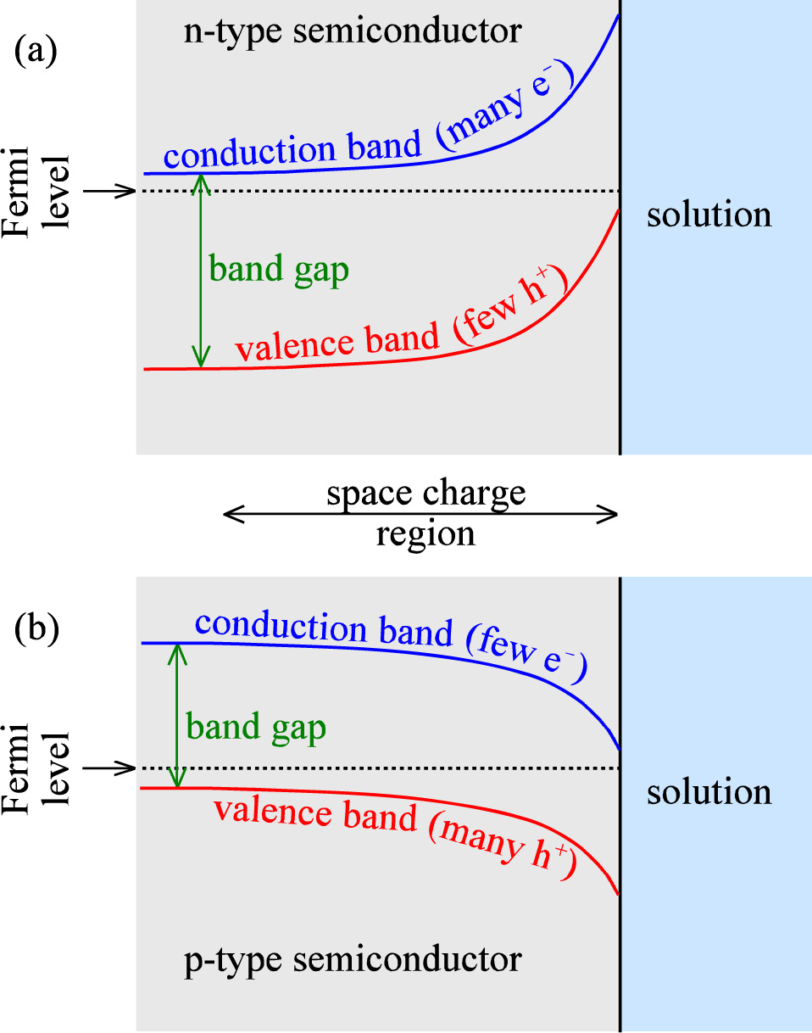
Semiconductor electrodes - overview
Semiconductor
Lattice
Valence band = HOMO
Conduction band = LUMO
Band gap
Fermio energy (chemical potential of electrons)
Work function (to bring electrons to vacuum)
n-type semiconductor
Donor-doped n = [e⁻] = [D⁺]
Electrons e⁻ in the conduction band
p-type semiconductor
Acceptor-doped p = [h⁺] = [A⁻]
Electron holes h⁺ in the valence band

Slide 5
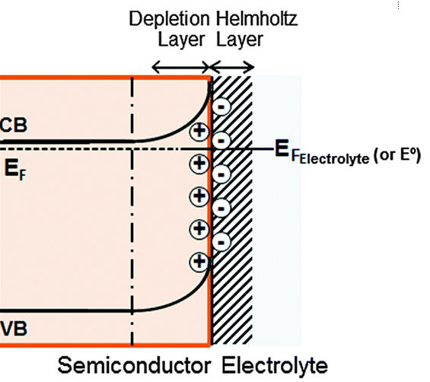
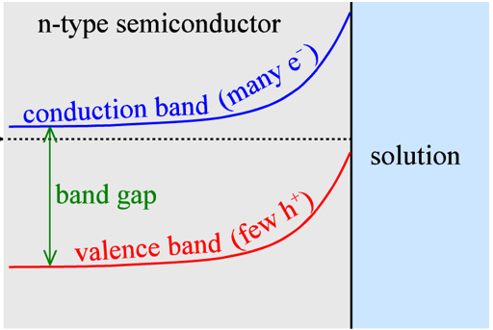
n-type electrode – a closer look
Electroneutrality in the semiconductor bulk
n + [A⁻] = p + [D⁺]
Bulk donor doped n-type conductor
n ≈ [D⁺]
Adsorption of anions in Helmholtz layer
compensated by
positive space charge in the semiconductor
by
depletion of electrons
excess of holes
Band bending:
Cause: Adsorption of one of the ions (same as diffuse layer in the electrolyte)
Shape: Same origin (Poisson) as diffuse layer in the electrolyte
-
+
-
+
-
+
-
+
-
+
-
+
-
+
-
+

Slide 6
Exercise
How do the bands look before contact with the electrolyte?
Based on your memory and understanding, populate the top figure with ions, electrons, and holes
Populate the bottom figure with ions, electrons, and holes
How could we force the bands flat?
What is the flat-band potential?
Try to populate the valence bands with electrons instead of holes

Slide 7
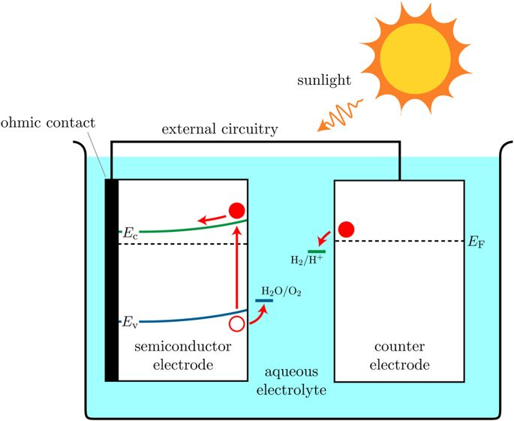
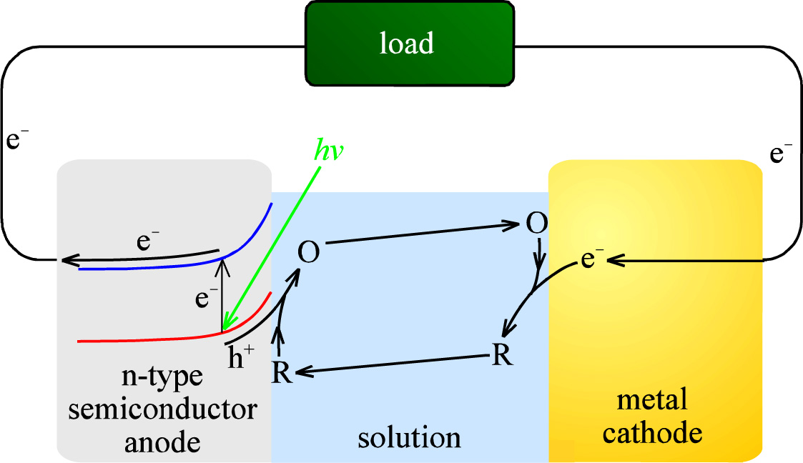
Photoelectrochemical (PEC) cell
n-type photoanode or p-type photocathode
Suitable bandgap
Charge separation
Photoanode

Slide 8
PEC water splitting, artificial photosynthesis
Low efficiencies
Photocorrosion of electrodes
Cathode traditionally a noble (platinum group) metal
Research: Non-noble metals, oxides. Enzymes
Sunlight cannot drive the reaction alone, just assist it
Research: Combine photoanode and photocathode. Combine PV and PEC.
Reduce CO₂ instead of H₂O
Solid-state electrolyte instead of aqueous

Slide 9
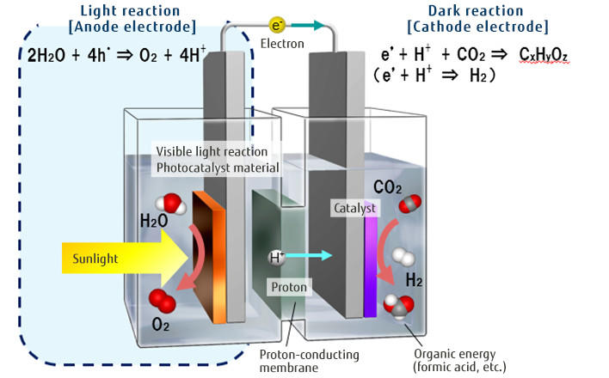
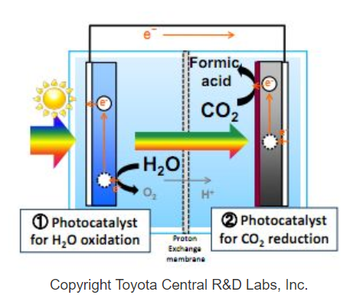
Artificial photosynthesis
Fujitsu Journal

Slide 10
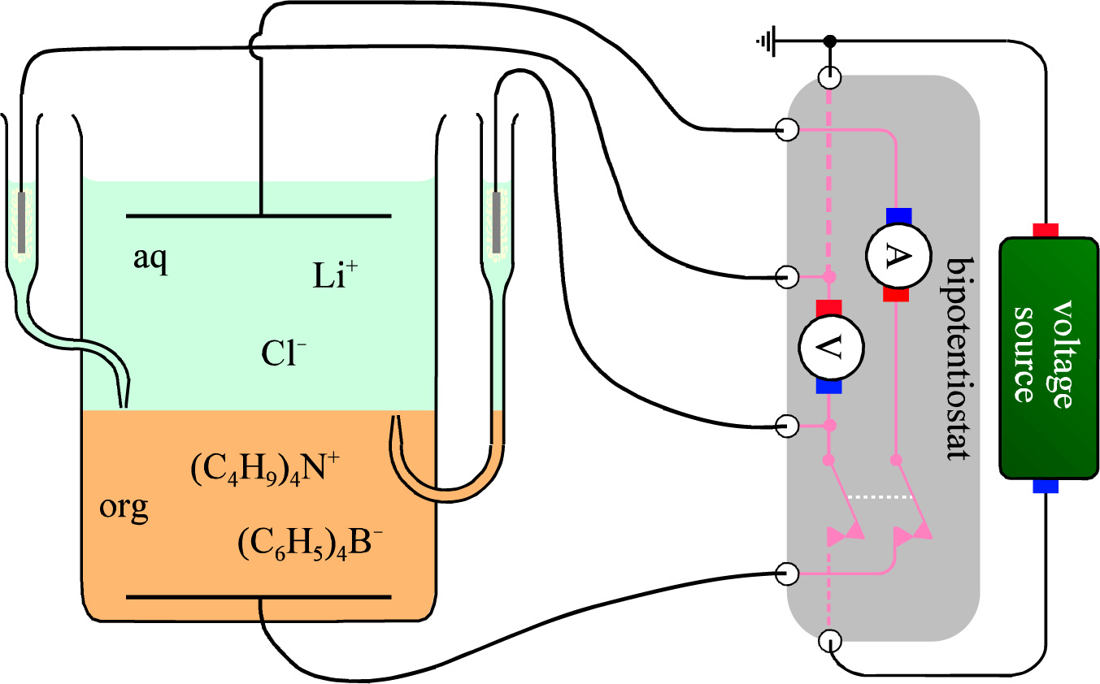
Interface between two immiscible electrolyte solutions (ITIES)
Aqueous vs organic liquids
Use of bipotentiostat

Slide 11
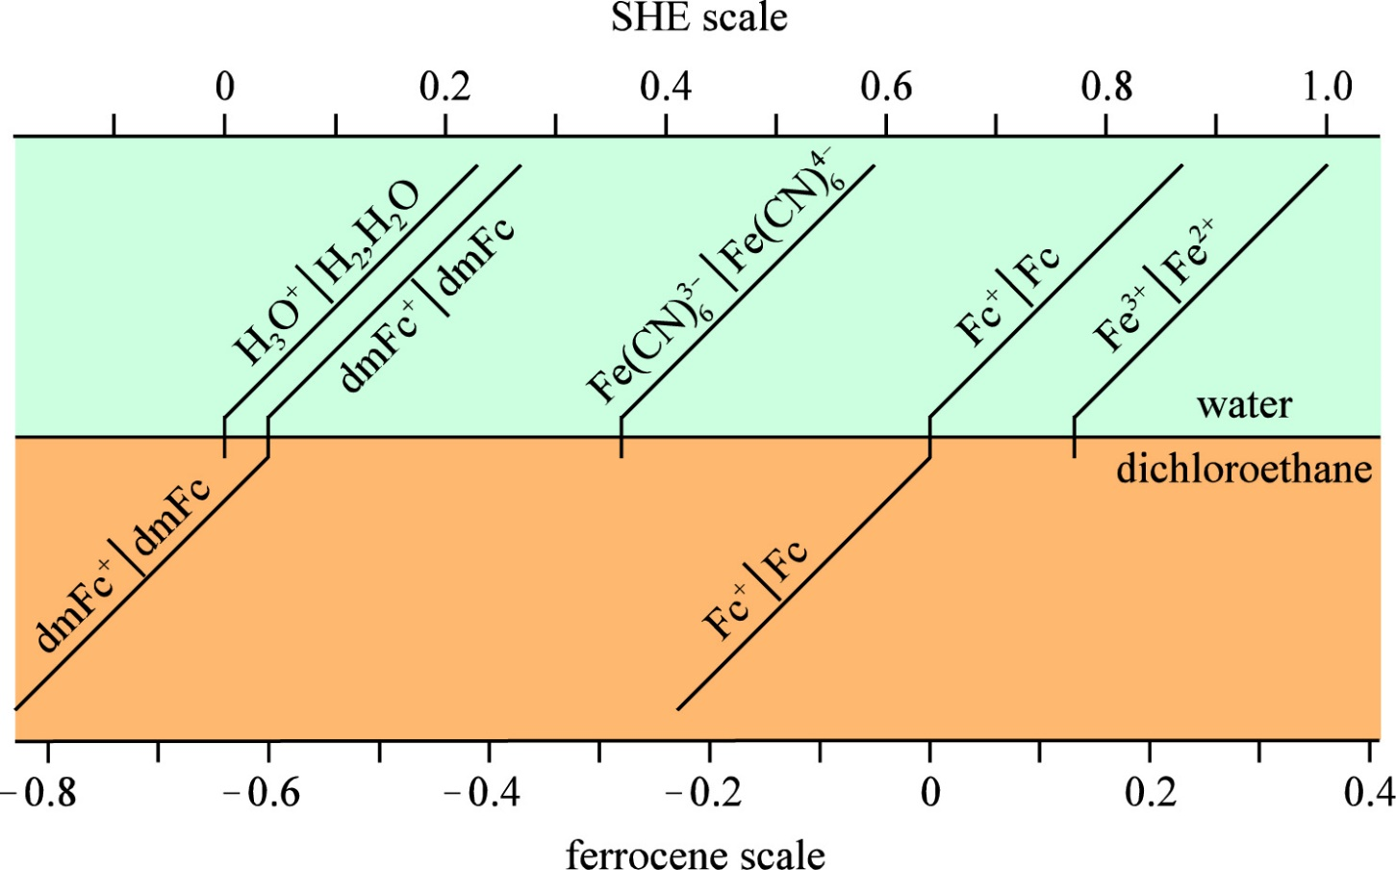
Redox scales – SHE and ferrocene (C₅H₅)₂Fe – for ITIES

Slide 12
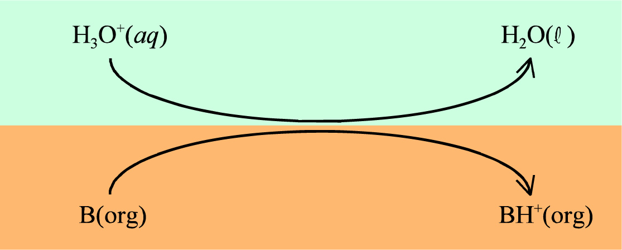
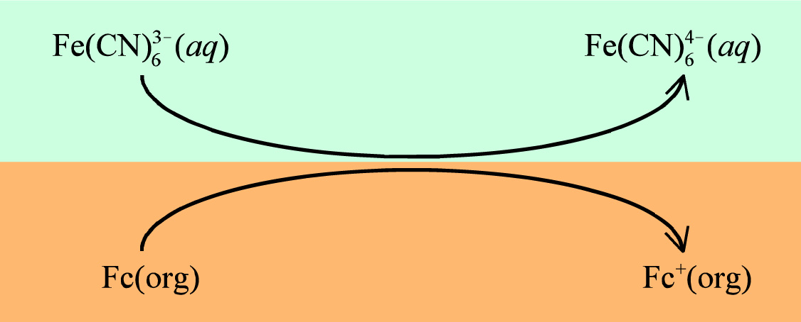
ITIES ion and electron transfers
Proton
Electron

Slide 13
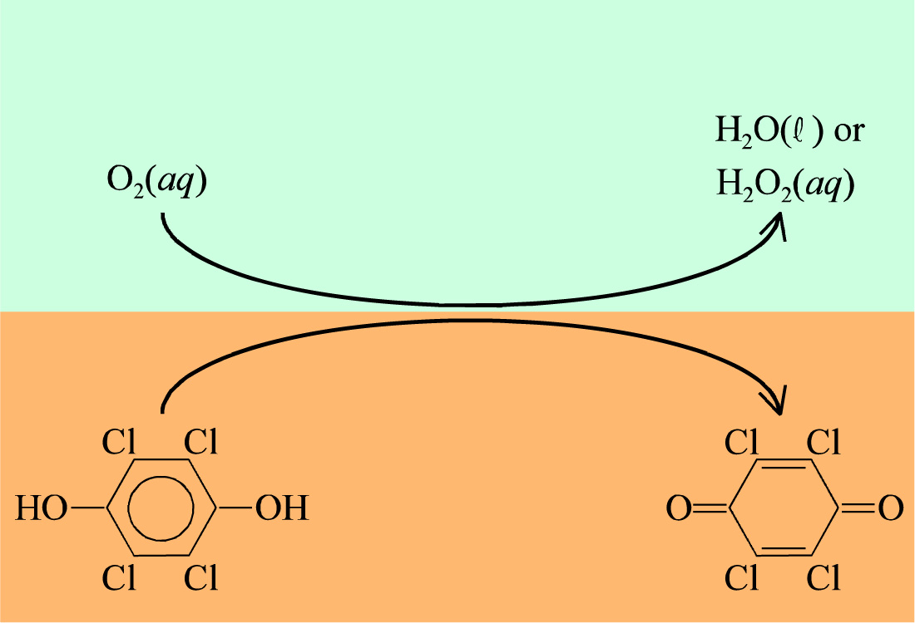
ITIES combined proton and electron transfers

Slide 14
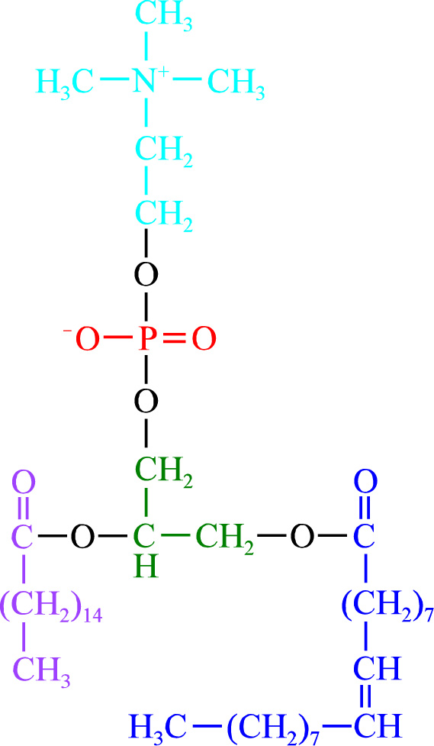
Phospholipid….
Zwitterion
Not curriculum

Slide 15
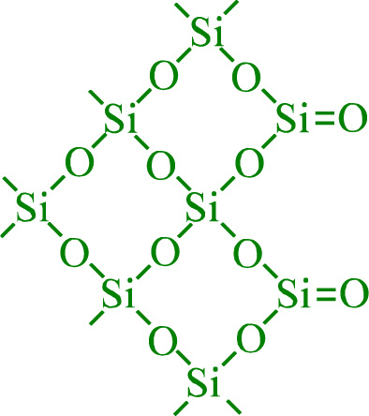
Electrokinetic phenomena
Electrolyte – insulator interface
No electrical current across
But double layers form
Scales with interface area: Porous materials, suspensions, etc.
Silica:
Terminating covalent O
H₂O adsorb
Protolyses weakly (Silica is weakly acidic)
Glass
Ionic alkali cations compenated by ionic terminating oxygen
Reduces acidity
Adsorption of cations like Al³⁺ may reverse the charge

Slide 16
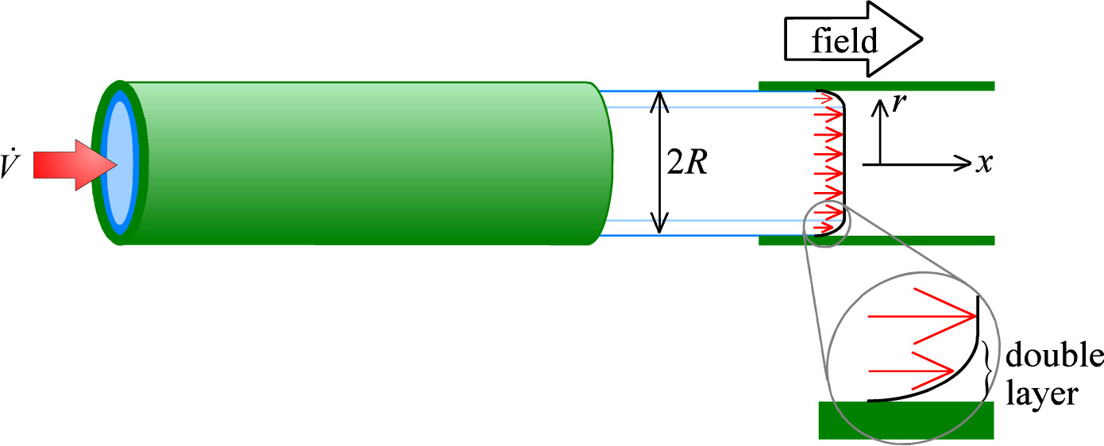
Electroosmotic drag
Friction between the positive double layer and the solution volume
Volume rate v (m³/s)
Field X, radius R, viscosity η
Zeta potential ζ at the slip plane
(zeta is ζ in the font set, not like in the formula in the textbook)
Similar to Helmhotz potential φ_{H}
Around -150 mV for glass, higher for silica
Electroosmotic flow is laminar, but it does not have the quadratic dependence of
velocity on radius, as described on pages 161162, that is seen in Poiseuille (laminar) flow. This is because electro-osmotic flow is not pressure-driven; instead, it is induced by friction from the motion of the field-driven sleeve. Thus the velocity profile is as shown in the Figure: it is uniform apart from within the narrow double-layer region.

Slide 17
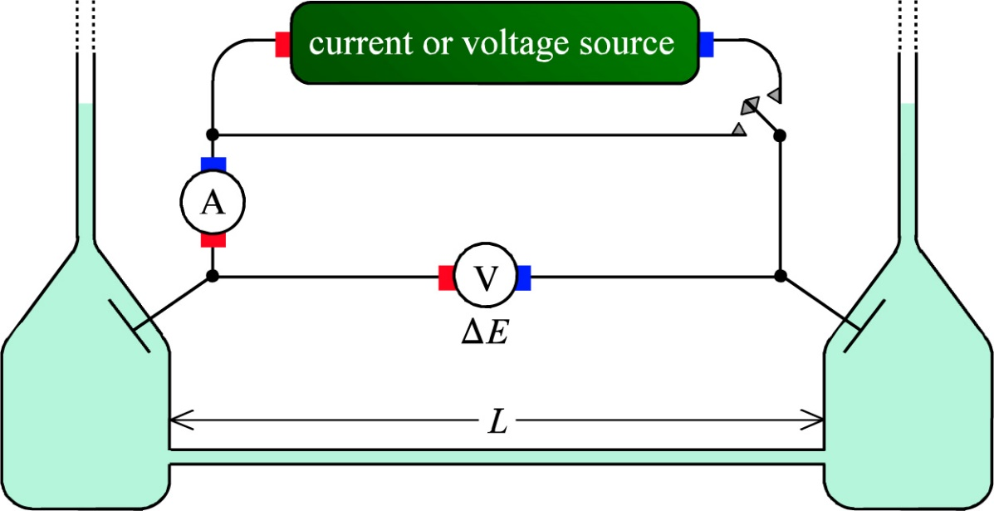
Electroosmotic drag
Electroosmotic flow by voltage or current
Electroosmotic pressure by voltage or current
Streaming potential or current by flow or pressure
Universality
Lars Onsager reciprocal relations
Irreversible thermodynamics
Nobel prize 1968
«Fourth law of thermodynamics»

Slide 18
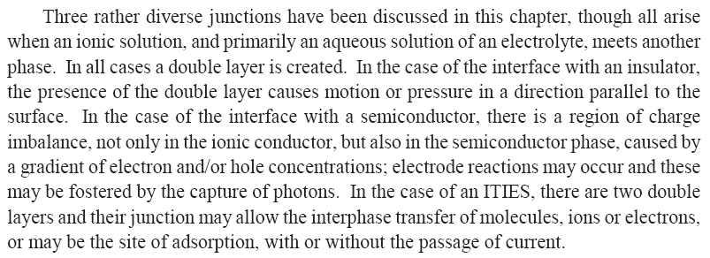
Ch. 14 Other interfaces - Summary

