Slide 1
Need Wifi?
Wifi at UiO is called «eduroam» - all of campus (including airports and other educational institutions)
Logg inn with UiO-username (<username>@uio) og UiO-password
No passord? Og to passord.uio.no and choose «new user»

Slide 2

Welcome new students in
Medier og kommunikasjon
Politisk kommunikasjon
Screen Cultures

Slide 3
Today’s meeting
Study programme and programme structure, courses, etc
Practical information
Student life in Oslo

Slide 4
Programme: structure, courses, signing up

Slide 5
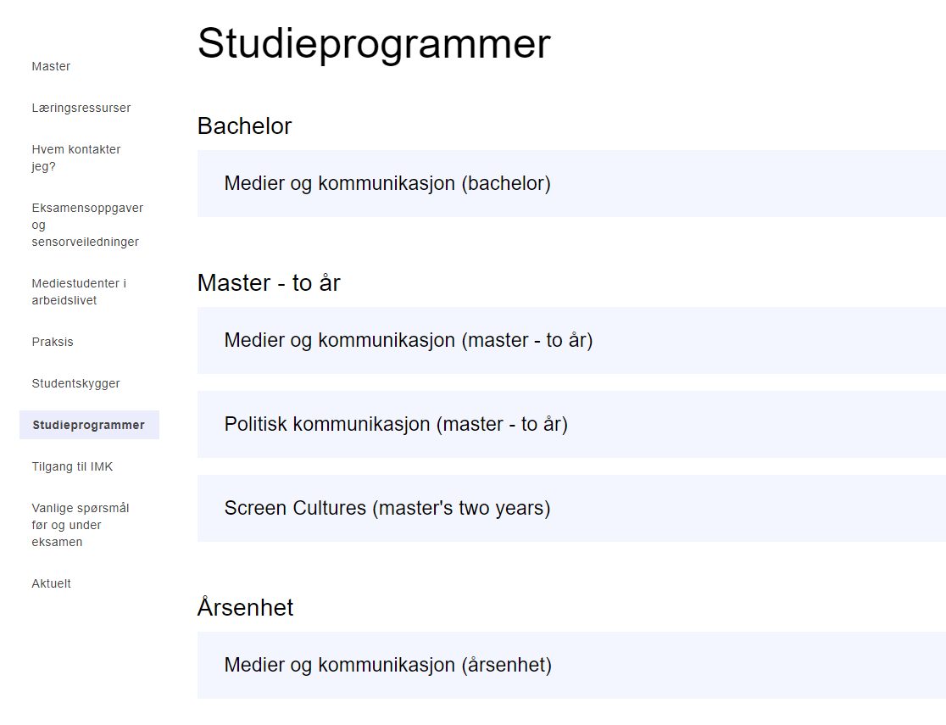

Slide 6
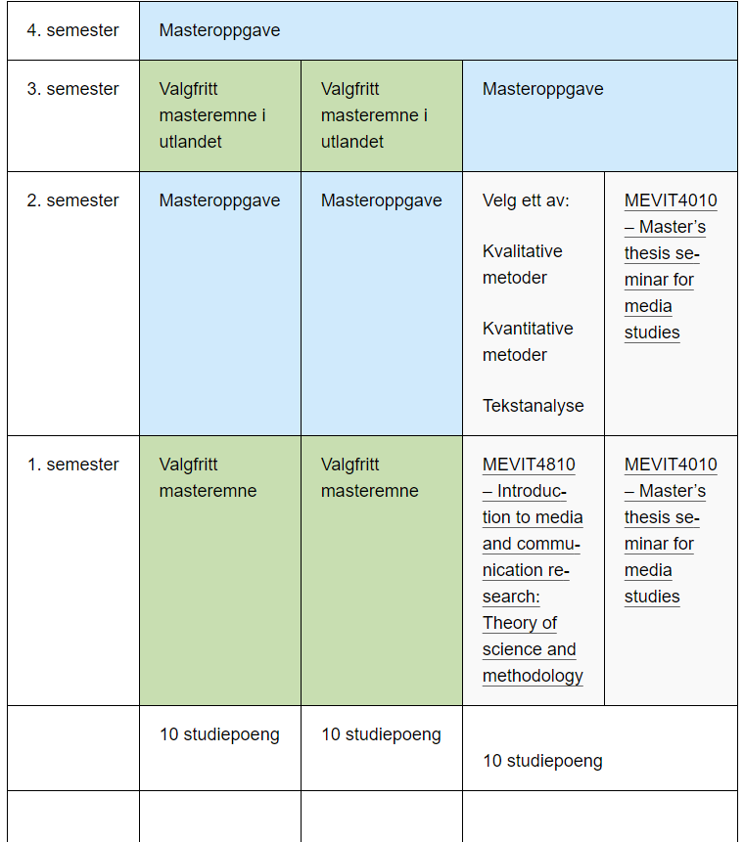
Thinking about studying abroad?
The third semester could alternatively be used for international student exchange, provided that students take the obligatory courses abroad (Varies from program to program)

Slide 7
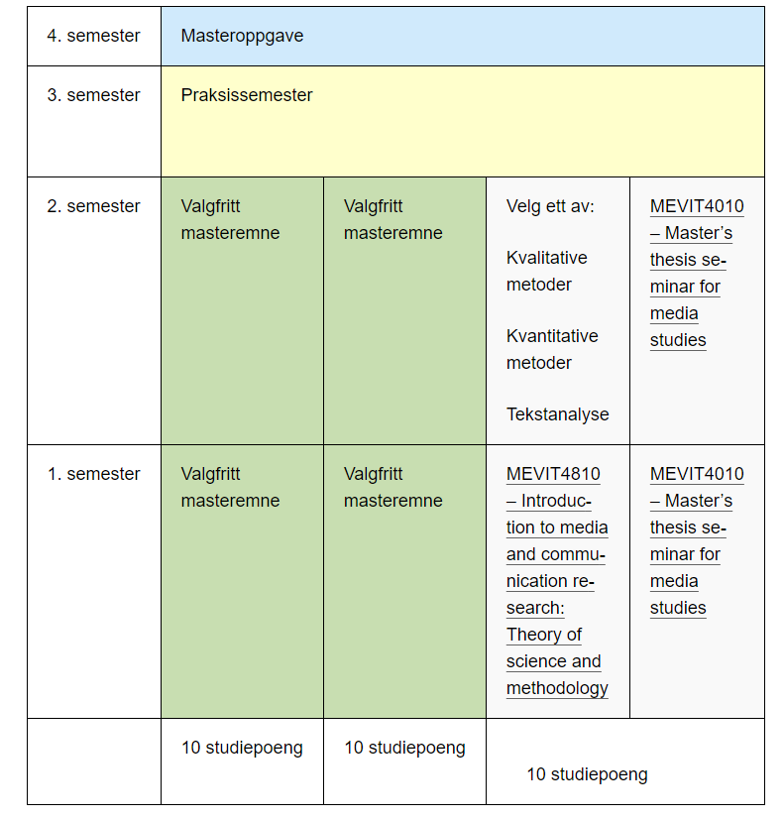
Alternative study structure with «Placement/Internship" and 30 ECTS Master's thesis

Slide 8
Other typs of courses
Courses at other departments: studieinfo@media.uio.no
Courses without teaching
  Research assistant, self composed courses
  Courses at OsloMet
  Studying abroad and/or Placement/Internship
  I will inform about exchange and Placement at the information meeting about exchange
Courses at IMK: https://www.uio.no/studier/emner/hf/imk/

Slide 9
Master’s thesis
MEVIT4010 – Master’s thesis seminar
Three semesters
Supervisor from second semester
Submission: June 2025

Slide 10
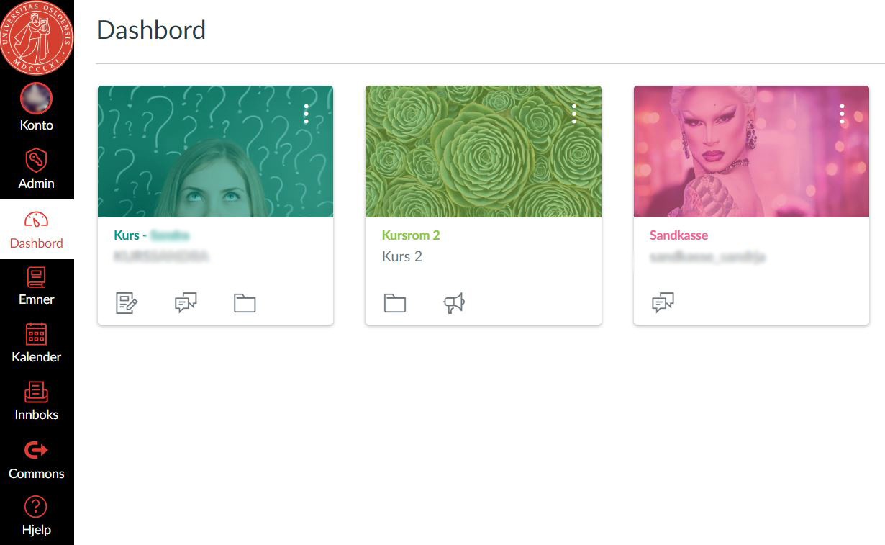
Canvas – online learning platform
Used for all courses at UiO
Log in with your UiO username and password
All courses you are admitted to will show up on the Dashboard
canvas.uio.no

Slide 11

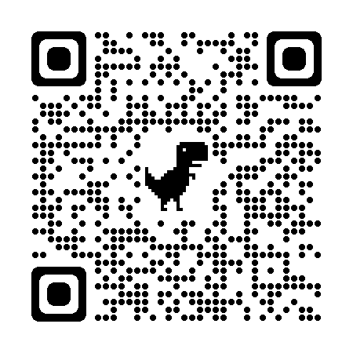
Jobbklar
- your pathway to working life
Welcome to your first year of study! From the start, Jobbklar can help you navigate student life and build a pathway to working life.
Go to My studies [app or desktop]
Choose the shortcut to Canvas and log on
Find Jobbklar on your dashboard

Slide 12
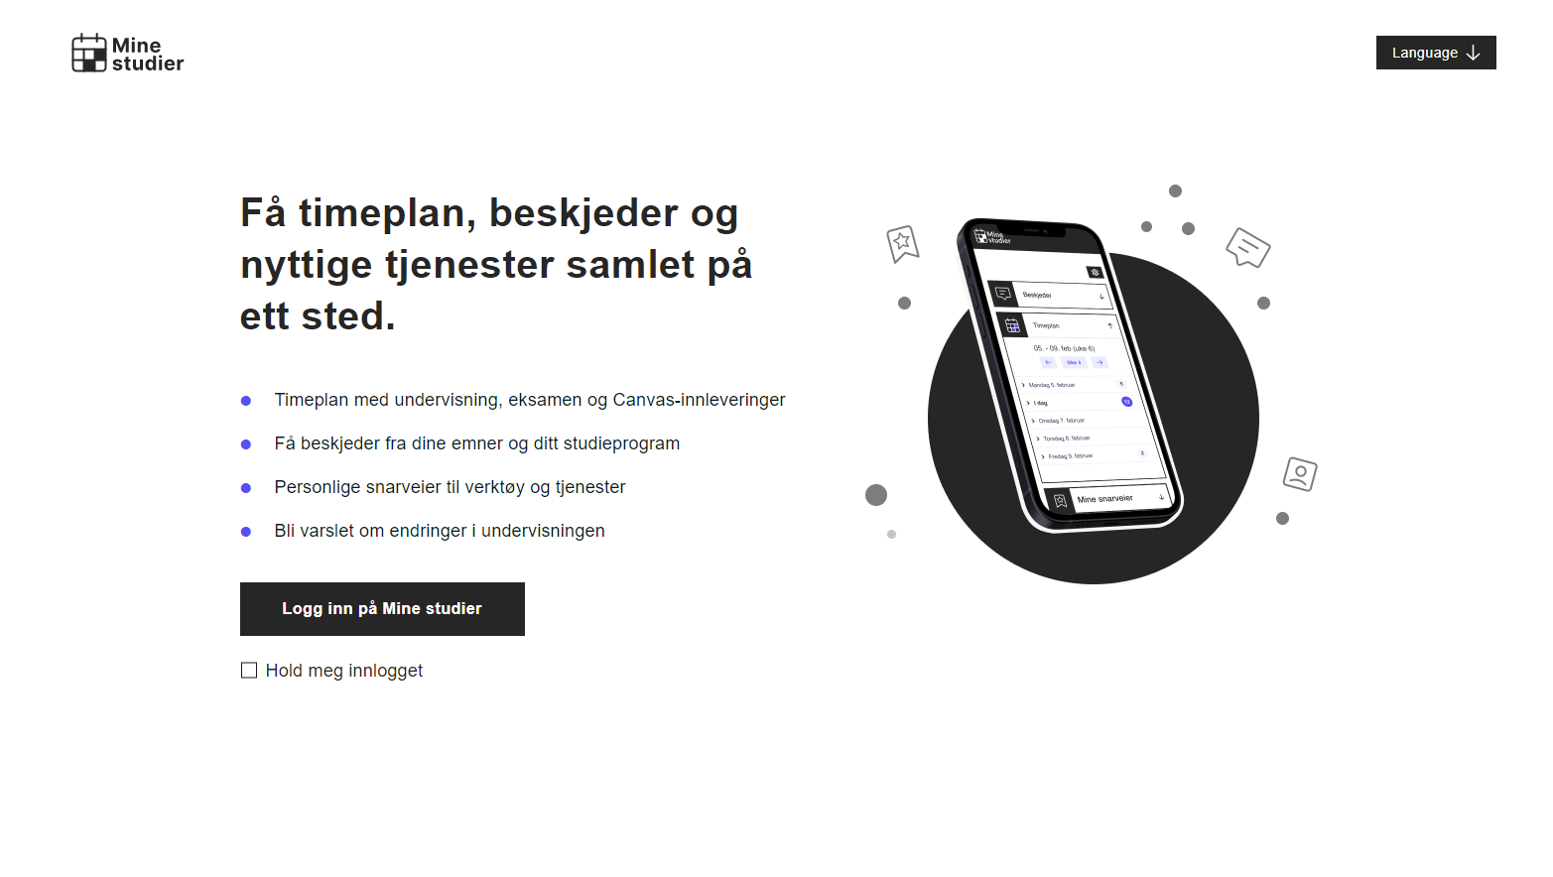
Demo av Mine studier
Notes:
Studentenes inngangsvei til det digitale læringsmiljøet
Demo scenario:
1. Krysse av for lang innlogging, 6 måneder med Feide
2. Gå inn på Beskjeder: Beskjeder hentes fra TP, Kull og emne i Canvas, Program og emnenettsider. Vis filtre.
3. Gå inn på timeplan: Undervisning med undervisningsressurser og eksamensinfo fra TP, oppgaver fra Canvas
Vis fokus-mulighet på oppgave og eksamen
Vis kalender-velger
Vis abonner på timeplanen og fortell
4. Mine snarveier
Her kan studenten selv velge hvilke verktøy han/hun ønsker lett tilgjengelig i Mine studier, stor fleksibilitet
I tillegg kan den enkelte student lage helt egne snarveier til nettsider/tjenester som de bruker i sine studier
Disse snarveiene er veldig mye brukt
5. Mine programmer og emner
Lenker til nettsidene til emner og program som studenter er påmeldt i
6. Mulig å bytte plass på timeplan og snarveier

Slide 13
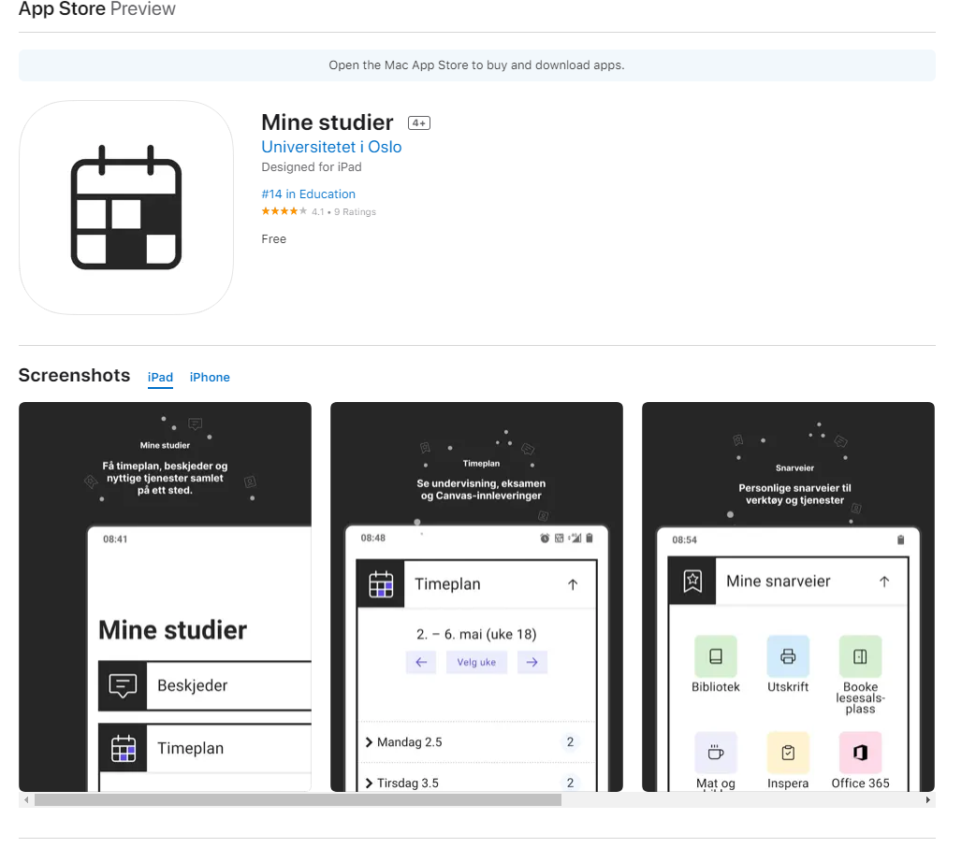
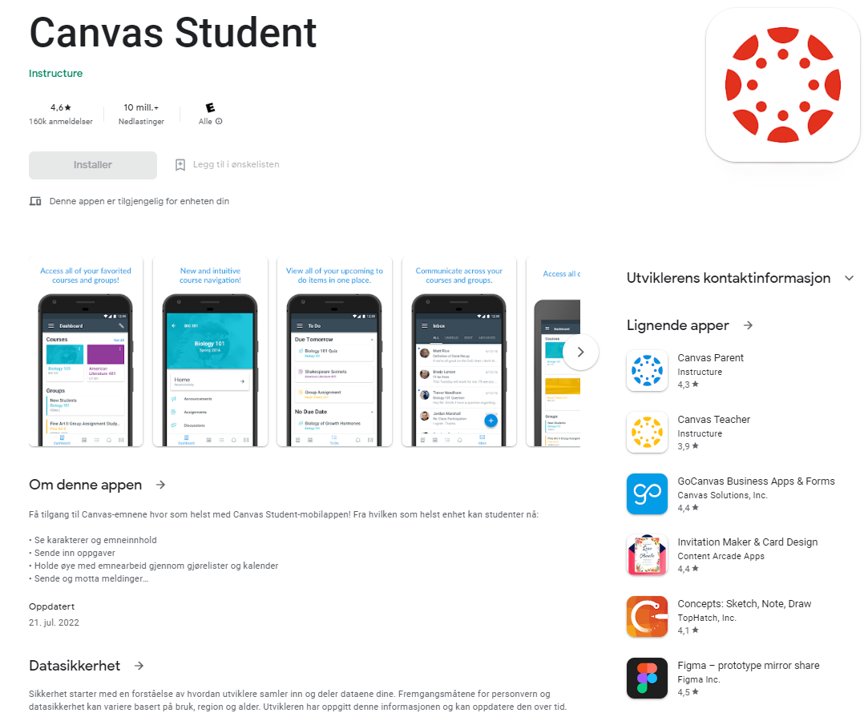
Download the apps!

Slide 14
Inspera – digital exams
Most exams at UiO are digital – all exams at IMK are
Log in with UiO username and password
Two types of exams
  School exams: conducted on UiO computers on campus or in Silurveien
  File submissions: three-day take-home exams or term papers, use your own computer and submit the file through Inspera online
Recommended preparations
  Log in and take test exams: https://uio.inspera.no
  Go to information meetings later in the semester

Slide 15
2: Practical information

Slide 16
Semester registration and student fee
NB! Every semester!
Final deadline: September 1 (Spring 2024: February 1)
studentweb.uio.no

Slide 17
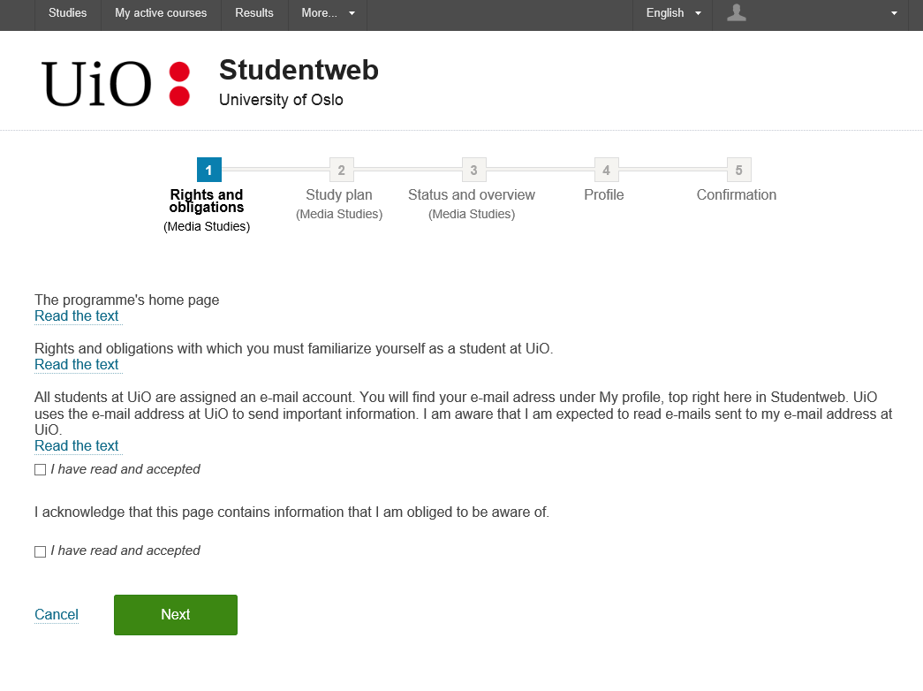

Slide 18
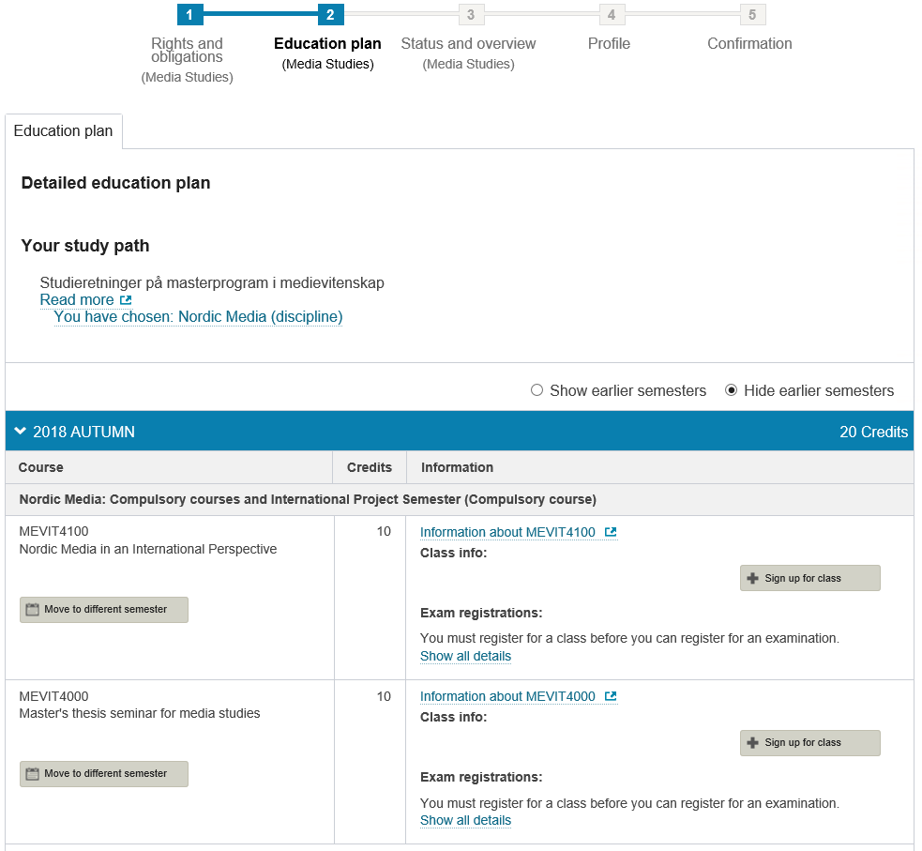
You must always sign up for courses – it is not enough to just have the course on your education plan

Slide 19
Study right and admission
2 years admission (autumn 2023 – spring 2025)
Exceptions:
Part-time studies
Leave of absence
DEADLINE 1 September / 1 February

Slide 20
Rights and obligations as a student at UiO
Check your UiO email often – follow deadlines – stay updated and informed
If you become ill (teaching)
If you become ill (exams)
You are entitled to advice and guidance regarding your study situation. We can make special arrangements when necassary – please get in touch with us!

Slide 21
Forward e-mails from your UiO e-mail
https://brukerinfo.uio.no/logon.php

Slide 22
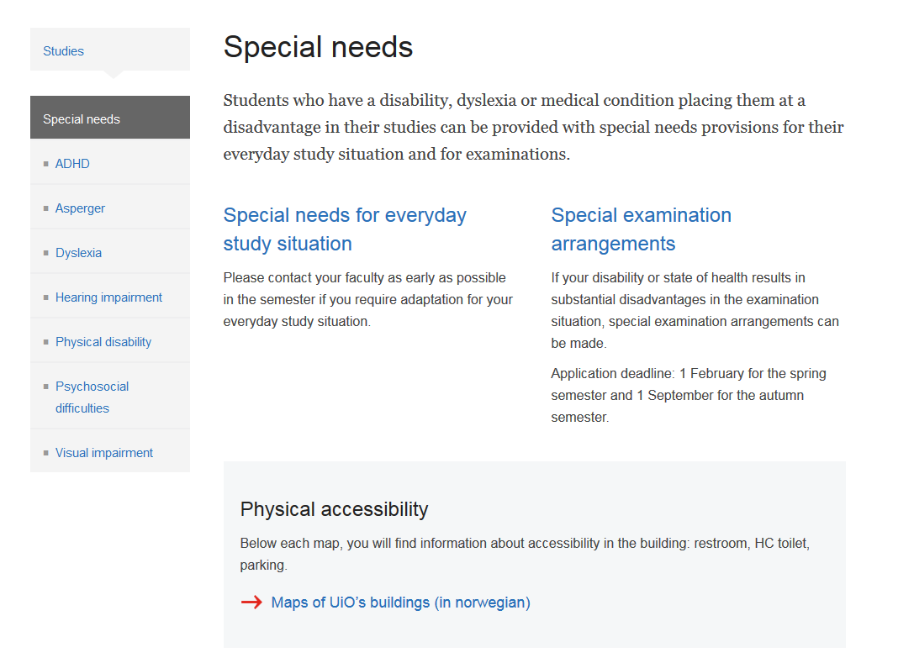
Special needs
Contact tilrettelegging@hf.uio.no
Reserved seat in study halls (lesesal)
Break rooms
Technical aids
Informing lecturers and professors on your behalf
Exam arrangments:
Extra time
Separate rooms
PC with word processor/spell check

Slide 23
Student card
1. StudentWeb + semester fee = Semester card (use the free Student ID app, or apply for a paper copy)
2. Bring semester card + ID to Knutepunktet = obtain student card from SiO (sio.no)
3. Semester card: valid for one semester only
Student card: valid for up to 5 years

Slide 24
Information
Read your UiO e-mail adress
Read our newsletter (on Fridays)
Web: media.uio.no
IMK on facebook
When in doubt, always ask: studieinfo@media.uio.no

Slide 25
3. Student life in Oslo

Slide 26


Get involved
The student committee at IMK or Faculty of Humanities
Student socities
PRESSET.
IMK
HF
UiO
Student activities at UiO

Slide 27

Save the date: 7-8 September all new master’s students at IMK are invited to a cabin in the forrest!

Slide 28

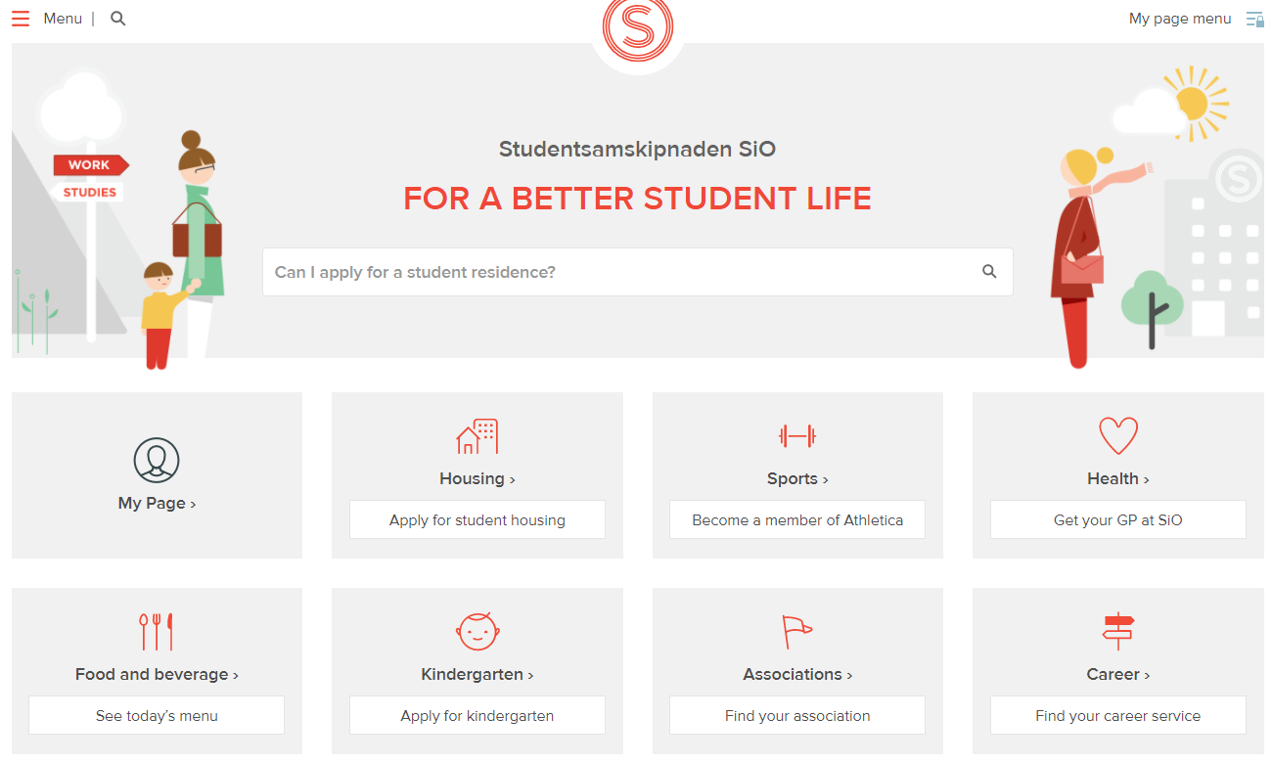
SiO – your best resource as a student

Slide 29
studieinfo@media.uio.no
www.media.uio.no

